Slide 1



BCAC0010: System Design & Software Engineering
Class Presentations on Introduction to System Design & Software Engineering

Slide 2






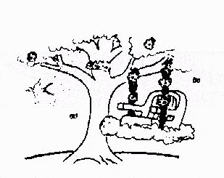
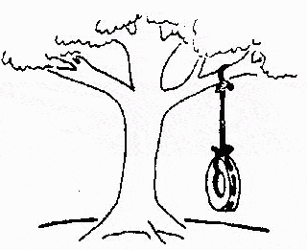
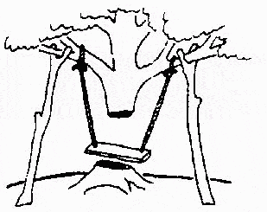
User participation is very essential
Developed by IBM in 1980
User participation is essential
This is how the
The requirements specification was defined like this
The developers understood it in that way
problem is solved now
This is how the problem was solved before.
This is how the program is described by marketing department
This, in fact, is what the customer wanted …
That is the program after debugging
12

Slide 3

The Rapid Application Development (RAD) Model
Build a rapid prototype
Give it to user for evaluation & obtain feedback
Prototype is refined
With active participation of users
Requirements
Planning
User
Description
Construction
Cut over
13

Slide 4

The Rapid Application Development (RAD) Model
Not an appropriate model in the absence of user participation.
Reusable components are required to reduce development time.
Highly specialized & skilled developers are required and such developers are not easily available.
14

Slide 5

Advantages of RAD model
It is very useful for those projects which requires
very short time period.
2) It emphasizes the use and development of reusable
components.
3) It follows a modular approach which new technology
uses for development.

Slide 6
Disadvantages of RAD model
For large and scalable projects RAD requires
sufficient human resources to create the right number
of RAD teams.
2) RAD is not appropriate when technical risk are high.
3) If developers and customers are not committed to the
rapid fire activities necessary to complete the system
in much abbreviated time frame, RAD projects will fail.
4) Not all types of application are appropriate for RAD
approach.

Slide 7
Spiral Model
It couples the iterative nature of prototyping with
controlled and systematic aspects of linear sequential
model.
software is developed in a series of incremental
releases.
This model views the development as a spiral process.
During early iterations the incremental release might be
a paper model or prototype.
It also takes into account risk assessment.

Slide 8
The angular dimension represents the
progress made in completing each cycle.
Each loop of the spiral from x-axis
clockwise through 360 degree represents
one phase.

Slide 9
The Spiral model is divided into a number of framework
activities also called task regions. These are:-
1) Customer communication:-
Task required to establish effective communication
between developer and customer.
2) Planning:-
Task required to define resources, timeliness, and
other project related information.
3) Risk analysis:-
Task required to access both technical and
management risk.

Slide 10
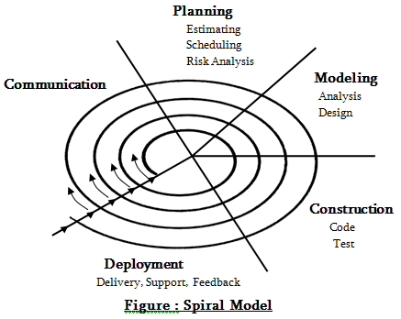

Slide 11
4) Engineering:-
Task required to build one or more representation of
the application.
5) Construction and release:-
Task required to construct, test, install, and provides
user support.
Eg Documentation and training.
6) Customer Evaluation:-
Task required to obtain customer feedback based on
evaluation of the software representation created
during the engineering stage and implemented during
the installation stage.

Slide 12

Advantages of Spiral model
It takes the best aspects of a number of other models
like it uses iterative approach of the incremental model
and also use prototyping to further refine requirements.
Within each iteration risk analysis and validation steps
eliminate errors in the phases of development.
This model is very useful for high risks projects.
It has verification activities and feedback within each
spiral.
It provides a mechanism to cope with changing user
requirements.

Slide 13
Disadvantages of spiral model
This model is not widely used because it is relatively
new and complicated concept.
This model is associated with iterative model. It also
has disadvantages of iterative model.
If requirements are well known and stable it has the
danger of becoming a waterfall like approach.

